Slide 1



Consumer Goods Ad_hoc insight
Presented By: Sanket Kumar

Slide 2
Atliq Hardware
ABOUT:
Atliq Hardwares (imaginary company) is one of the leading computer hardware producers in India and well expanded in other countries too.
PROBLEM:
The management noticed that they do not get enough insights to make quick and smart data-informed decisions. They want to expand their data analytics team by adding several junior data analysts. Tony Sharma, their data analytics director wanted to hire someone who is good at both tech and soft skills. Hence, he decided to conduct a SQL challenge which will help him understand both the skills.

Slide 3
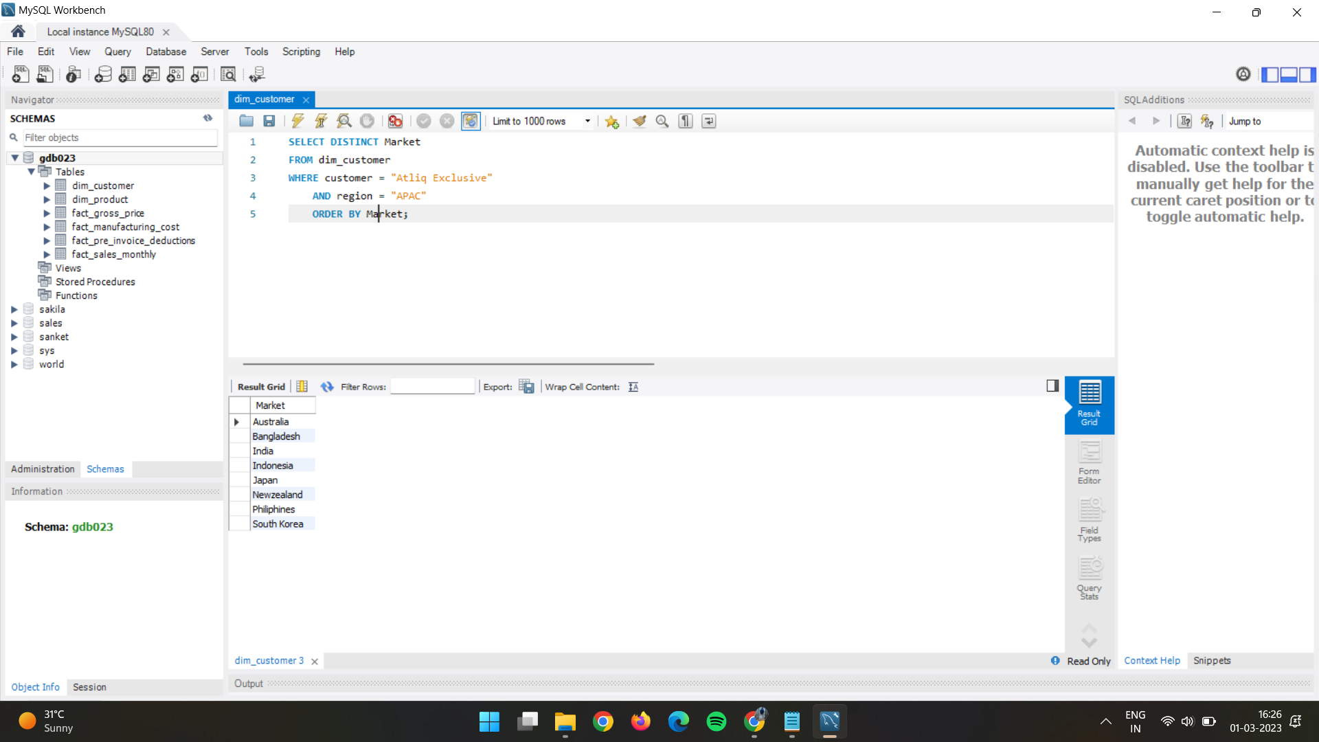
List of Market of Atliq Exlusive in APAC Region
Question 1:
Provide the list of markets in which customer "Atliq Exclusive" operates its business in the APAC region.
Output:

Slide 4
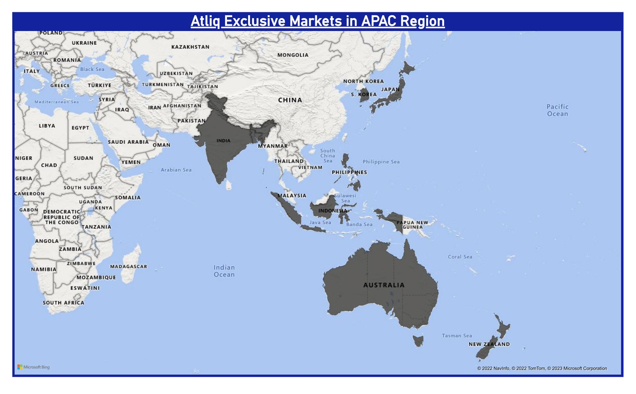
Conversion of Output to Visual
INSIGHTS:
Atliq producers computer hardware in India and well expanded in other countries too. But Atliq Exclusive customer operates its business in the APAC region in only 8 Market and that markets are: Australia, Bangladesh, India, Indonesia, Japan, Newzealand, Philippines, and South Korea.

Slide 5
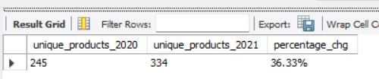
Percentage of Unique product increase in 2021 over 2020
Question 2:
What is the percentage of unique product increase in 2021 vs. 2020? The final output contains these fields,
unique_products_2020
unique_products_2021
percentage_chg
Output:

Slide 6
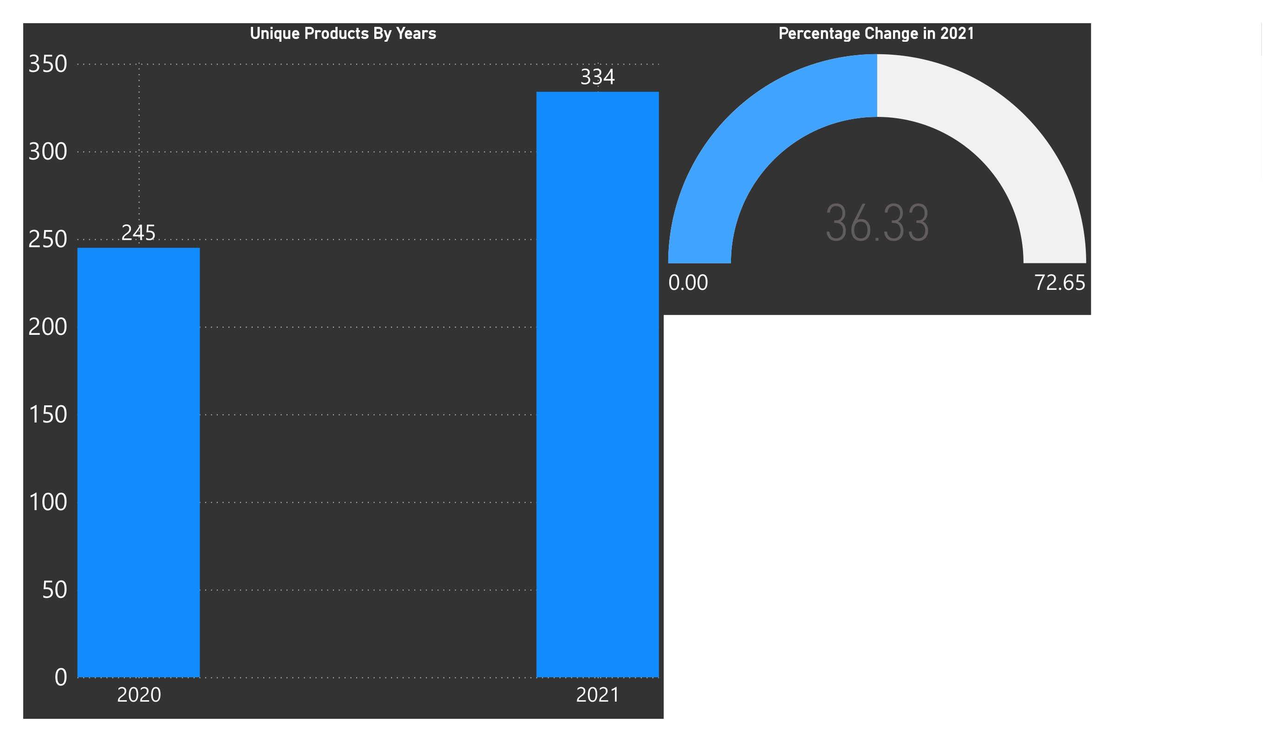
Conversion of Output to Visual
INSIGHTS:
In the year of 2021 No. of unique product increase as compare to 2020.
Total 89 New unique product introduce by Atliq Hardware in 2021.

Slide 7
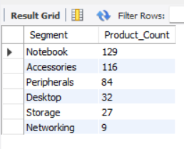
Number of Unique Product in Each Segment
Question 3:
Provide a report with all the unique product counts for each segment and sort them in descending order of product counts. The final output contains 2 fields,
segment
product_count
Output:

Slide 8
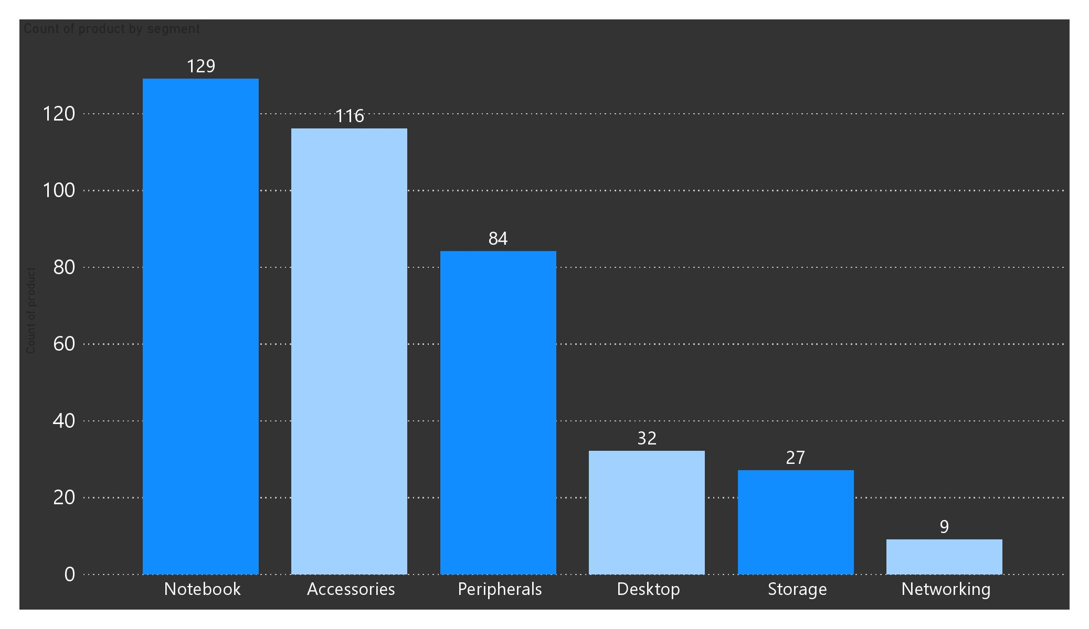
Conversion of Output to Visual
INSIGHTS:
Based on output result we can see segment Notebook Has maximum Unique Product.
In Networking Segment number of unique product is minimum.

Slide 9
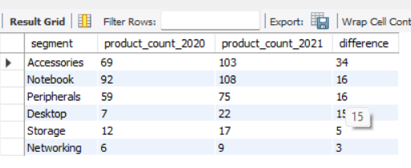
Segment wise increment in unique product 2020 vs 2021
Question 4:
Follow-up: Which segment had the most increase in unique products in 2021 vs 2020? The final output contains these fields,
segment product_count_2020
product_count_2021
difference
Output:

Slide 10
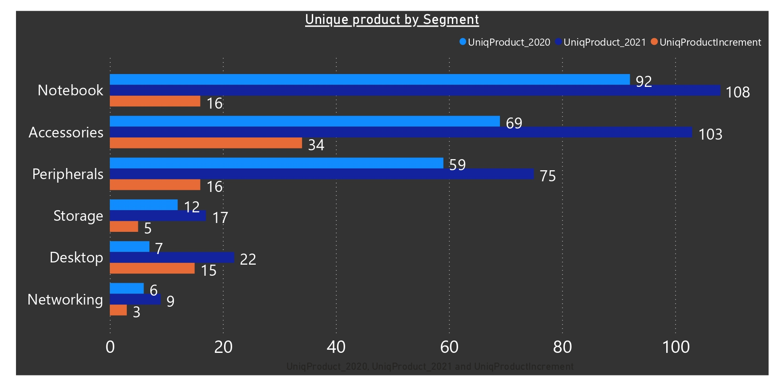
Conversion of Output to Visual
INSIGHTS:
Based on output result in 2021 every segment, number of unique product increased compared to year 2020.
Accessories Segment increase maximum number of unique product(34) that is 38.20% increment.
Networking Segment increase minimum number of unique product(3) that is 3.37% increment.

Slide 11
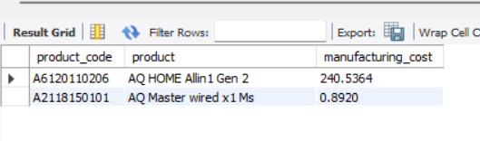
Products With Highest & Lowest Manufacturing Cost
Question 5:
Get the products that have the highest and lowest manufacturing costs. The final output should contain these fields,
product_code
product
manufacturing_cost
Output:

Slide 12
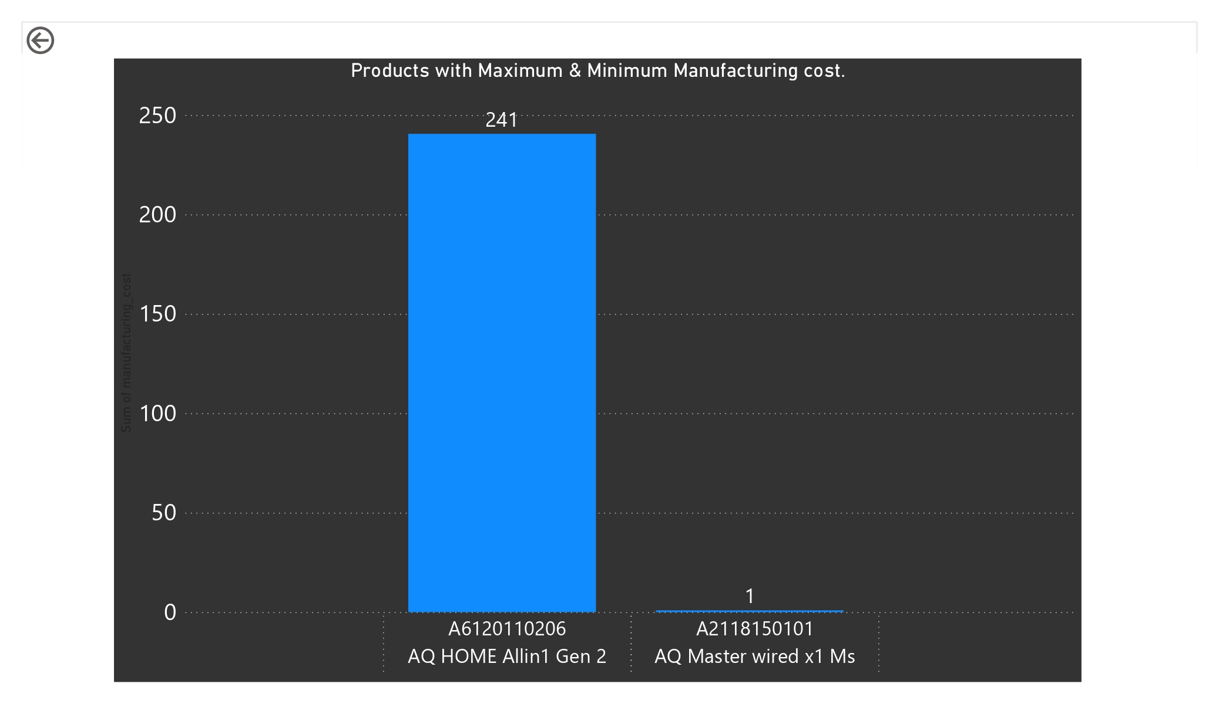
Conversion of Output to Visual
INSIGHTS:
Product “AQ Home Allin 1 Gen 2” has maximum manufacturing cost of 240.54 unit.
Product “AQ Master wired x1 Ms” has minimum manufacturing cost of 0.90 unit.
NOTE: cost unit in not given here.

Slide 13
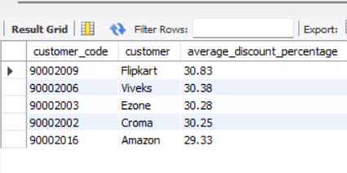
Top 5 customer with average high pre_invoice_discount_pct in 2021 and the Indian market.
Question 6:
Generate a report which contains the top 5 customers who received an average high pre_invoice_discount_pct for the fiscal year 2021 and in the Indian market. The final output contains these fields,
customer_code
customer
average_discount_percentage
Output:

Slide 14
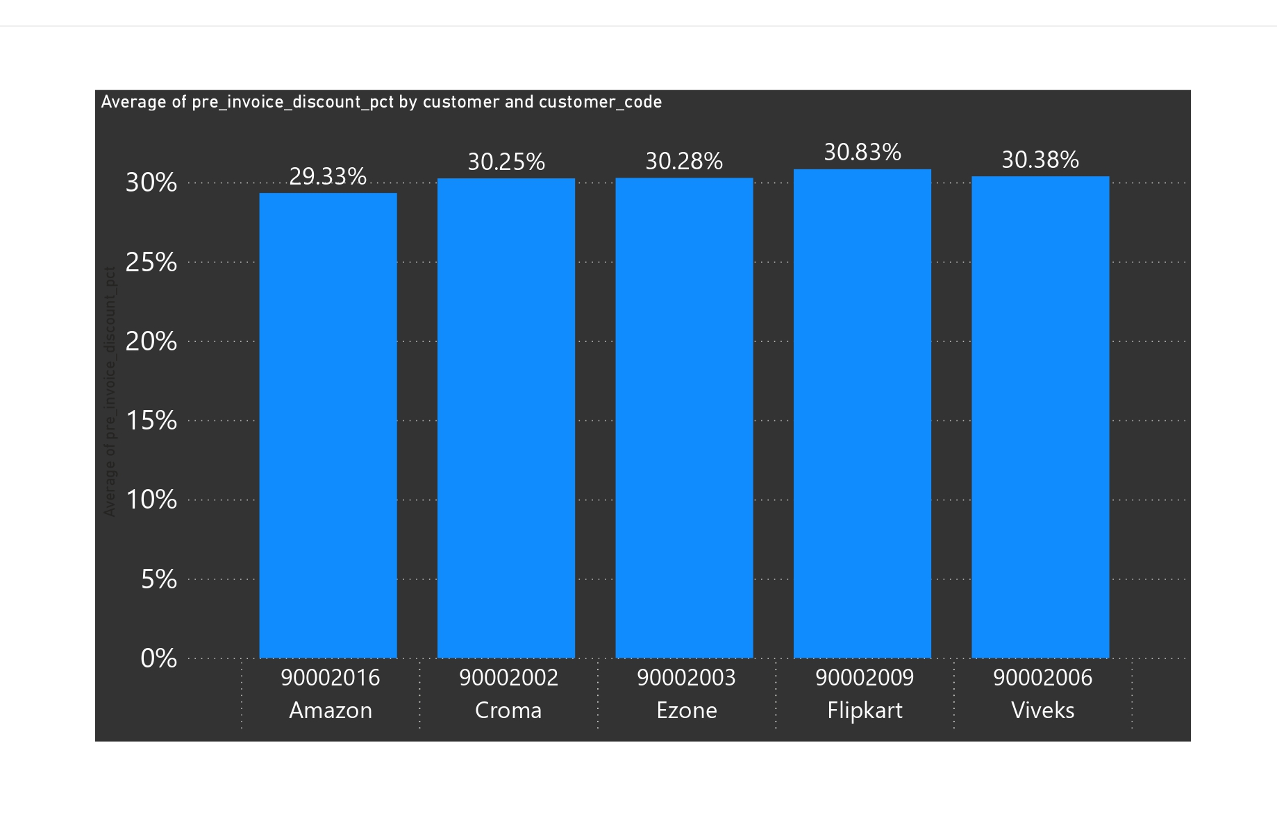
Conversion of Output to Visual
INSIGHTS:
Amazon, Croma, Ezone, Flipkart and Viveks are the top 5 customers with high average discount in INDIA in Fiscal Year 2021.
Above result order by customers name.

Slide 15
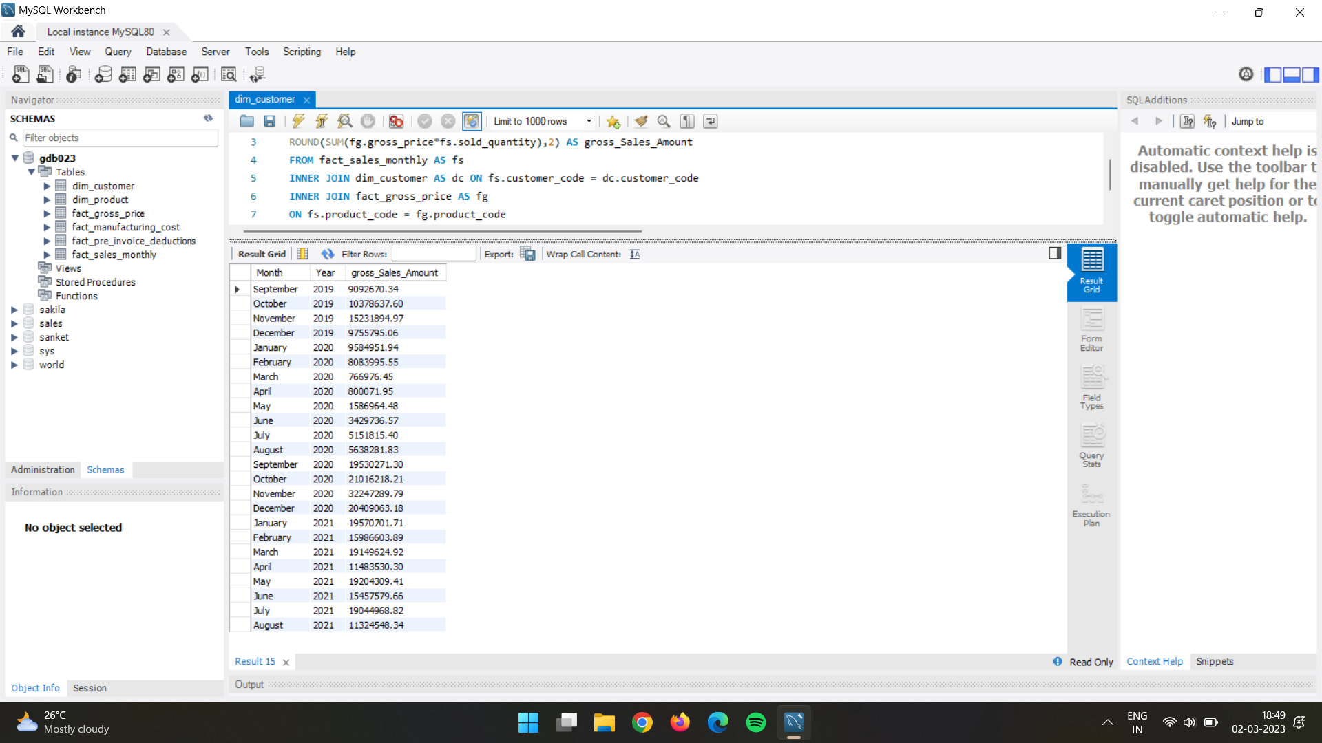
Gross sales amount for the customer of “Atliq Exclusive” for each month.
Question 7:
Get the complete report of the Gross sales amount for the customer “Atliq Exclusive” for each month. This analysis helps to get an idea of low and high-performing months and take strategic decisions. The final report contains these columns:
Month
Year
Gross sales Amount
Output:
INSIGHTS:
In November 2020 has maximum gross_sales_amount.
And the Lowest sales was in march 2020.

Slide 16
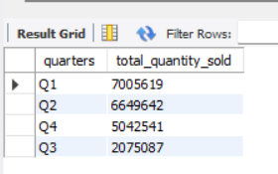
Quarterly Maximum Sold Quantity in fisal_year 2020
Question 8:
In which quarter of 2020, got the maximum total_sold_quantity? The final output contains these fields sorted by the
total_sold_quantity
Quarter total_sold_quantity
Output:
INSIGHTS:
In Quarters 1 number of product sold maximum whereas in Quarter 3 minimum .

Slide 17
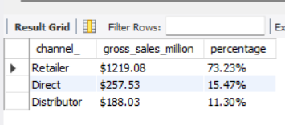
Quarterly Maximum Sold Quantity in fisal_year 2020
Question 9:
Which channel helped to bring more gross sales in the fiscal year 2021 and the percentage of contribution? The final output contains these fields,
channel
gross_sales_mln
percentage
Output:
INSIGHTS:
Channel Retailer cover around ¾ Gross sales in 2021.
And Distributor cover least amount of sales in fiscal year 2021.

Slide 18
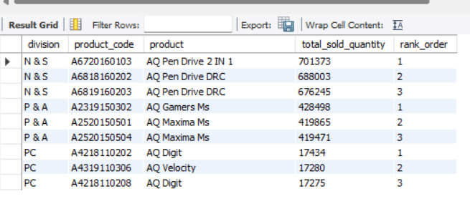
Quarterly Maximum Sold Quantity in fisal_year 2020
Question 10:
Get the Top 3 products in each division that have a high total_sold_quantity in the fiscal_year 2021? The final output contains these fields,
Division
product_code
product
total_sold_quantity
rank_order
Output:

Slide 19
Final Report
In APAC Region total 8 markets where customer is Atiq-Exclusive.
Unique product increase by 36.33% in year of 2021 as compare to 2020.
Notebook segment has maximum unique product.
Networking segment has minimum unique product.
In Every segment number of unique product is increased as compare to 2020.
Product “AQ Home Allin 1 Gen 2” has maximum manufacturing cost price.
Product “AQ Master wired x1 Ms” has minimum manufacturing cost price.
Amazon, Croma, Ezone, Flipkart and Viveks are the top 5 customers with high average discount in INDIA in Fiscal Year 2021.

Slide 20
Thankyou
Sanket Kumar!

